Slide 1


Wheat for Health: Addressing Micronutrient Deficiency
Wolfgang H. Pfeiffer
Global Director Product Development & Commercialization
w.pfeiffer@cgiar.org

Slide 2
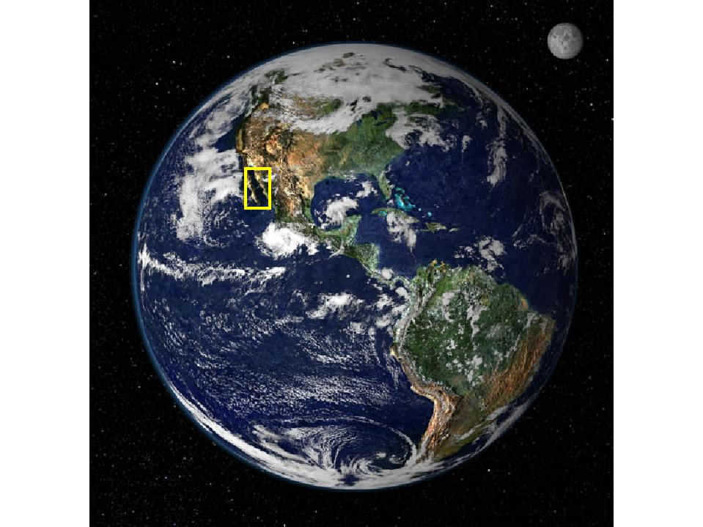
The 21st Century faces Major Food Security Challenges

Slide 3
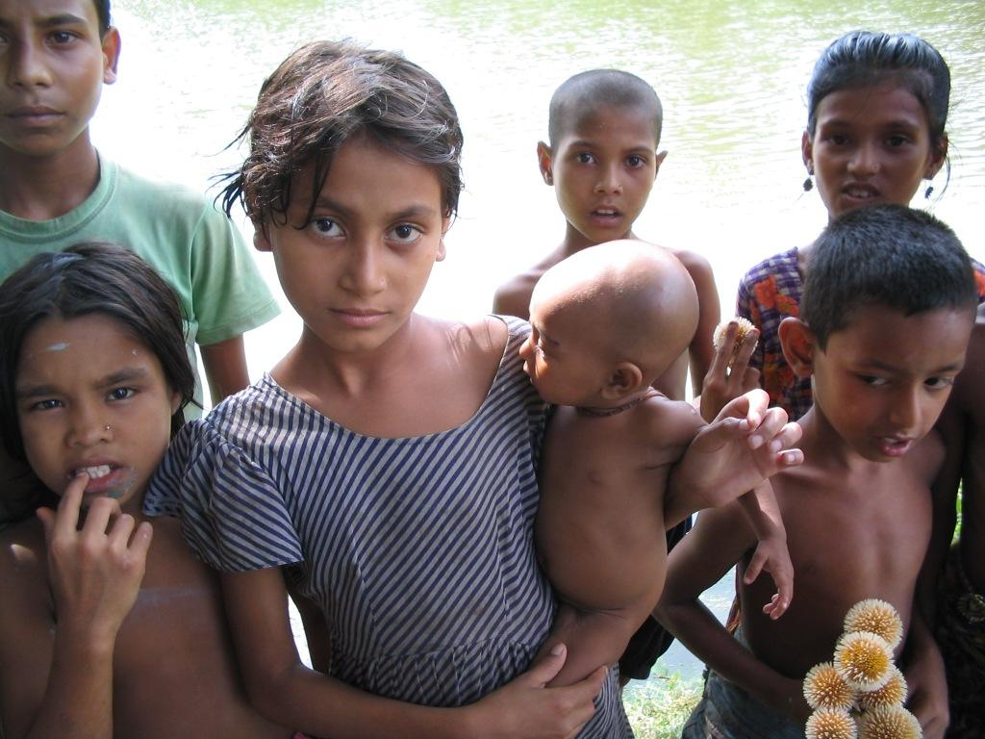

Micronutrient Deficiency
2 billion people in the developing world are iron deficient
Women and children are the
primary victims
Hidden Hunger
Micronutrient Deficiency
2 billion+ affected
Photo: C. Hotz
Wolfgang H PFEIFFER
Notes:
Fe: Impairs mental development and learning capacity in childhood and adolescence; Limits the capacity to perform physical labor;
Zn: Growth failure; Susceptibility to infections; Diarrhea; Skin lesions
Vita A: 500,000 children go blind each year from Vitamin A deficiency: most of them die; This is the single most important cause of total blindness in the developing world; It damages the immune system, intestines and lungs250 million of the world’s children are Vitamin A deficient

Slide 4
addressed by
HarvestPlus - an interdisciplinary, global alliance of more than 200 scientific and implementation partners in over 40 countries that seeks to reduce hidden hunger and provide micronutrients directly through … high-yielding, high-profit varieties of key staple foods that they eat
HarvestPlus is a joint venture between two CGIAR Centers, the International Center for Tropical Agriculture (CIAT) based in Cali, Colombia and the International Food Policy Research Institute (IFPRI) based in Washington, D.C.
Notes:
HPlus activities embrace entire value chain; sustainable markets for seed/planting materials and produce; value proposition for growers and consumers
HarvestPlus is a joint venture between two CGIAR Centers, the International Center for Tropical Agriculture (CIAT) based in Cali, Colombia and the International Food Policy Research Institute (IFPRI) based in Washington, D.C.
Target crops are the main calorie source in developing countries and by adding micronutrients & enhancing their nutritional value – HarvestPlus provides the LINK between Agriculture and Health

Slide 5
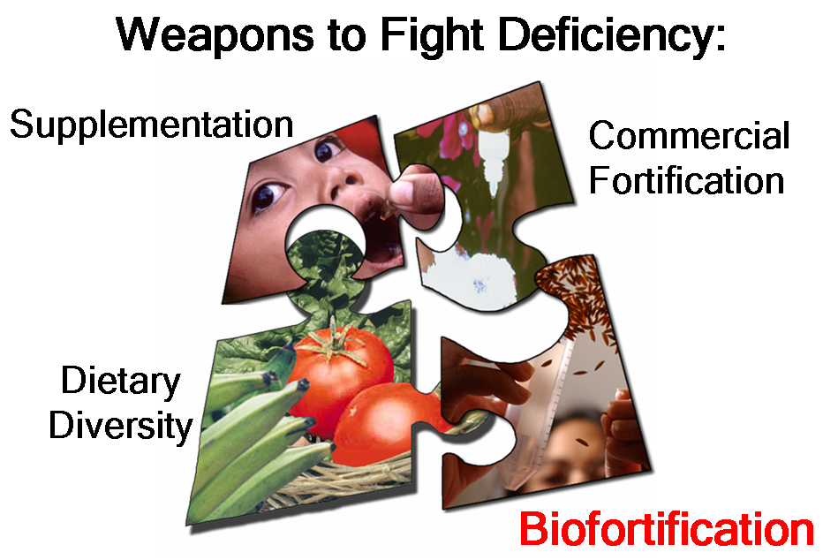
What can We do now?
Diversify the diet
expensive & out of reach for many
Fortify Food e.g. with iron, iodine
need access to the market - buy processed food
Provide Supplements e.g. vitamin A, iron, zinc
need access to the health care system - high delivery cost

Slide 6
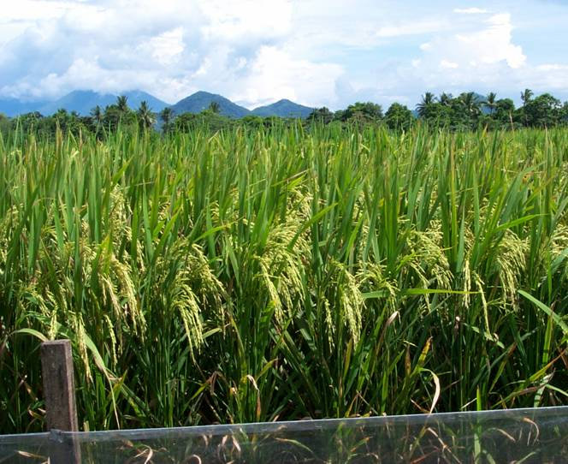
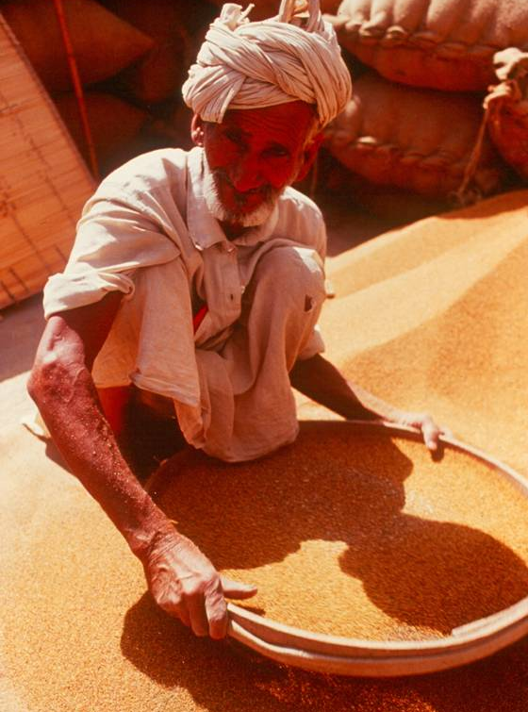
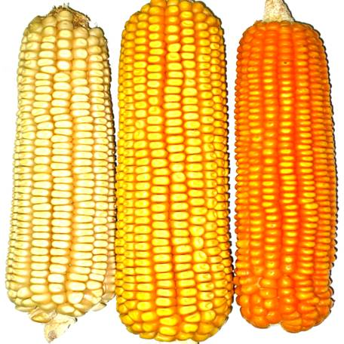
What can Biofortification do?
Biofortification is a process of increasing the density of vitamins and minerals through plant breeding or agronomic practices
Develop wheat, rice, maize, cassava and other staples packed with additional vitamins or minerals….
Nutritional benefits coming from the crops, harvest after harvest, with no additional costs
Reach those who are not reached by other nutrition interventions
Notes:
… a process called biofortification…

Slide 7
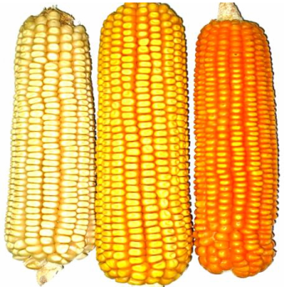
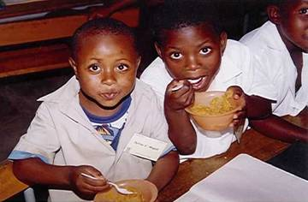
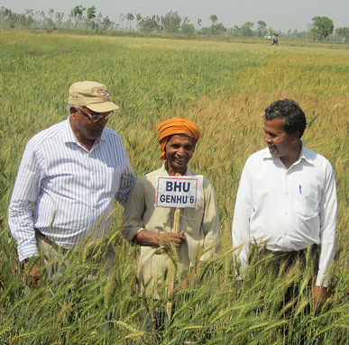
Will Biofortification Work?
Can breeding increase nutrient levels enough to improve human nutrition?
Will the extra nutrients be bioavailable at sufficient levels to improve micronutrient status?
Will farmers adopt and will consumers buy/eat in sufficient quantities?

Slide 8
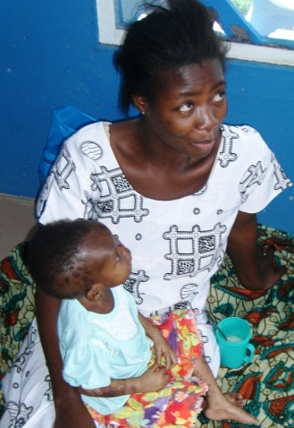
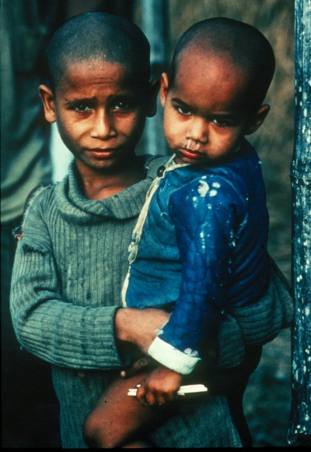
HarvestPlus Impact & Product Pathway
Discovery: HPlus I 2004-2008
Identify Target Populations & Staple food consumption
Determine Cost /Benefit compared to other Interventions
Setting Nutrient Target Levels
Screening & Determine Breeding Feasibility
Development of Crop Product Concepts

Slide 9
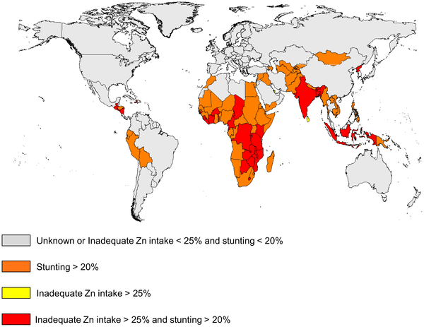
Importance of Zinc Deficiency
Zinc deficiency is common in developing countries with high infant and child mortality
Zinc commonly the most deficient nutrient in food fed to infants during weaning – a critical period for development
Globally 17.3% of the population has inadequate zinc intakes, with highest estimates in Africa (23.9%) and Asia (19.4%).
Notes:
Zinc essential for the function of many enzymes and metabolic processes
Zinc deficiency is common in developing countries with high mortality
Zinc commonly the most deficient nutrient in complementary food mixtures fed to infants during weaning
Zinc interventions are among those proposed to help reduce child deaths globally by 63% (Lancet, 2003;2008) but there is no internationally endorsed preventive zinc intervention because of the difficulty of measuring impact

Slide 10
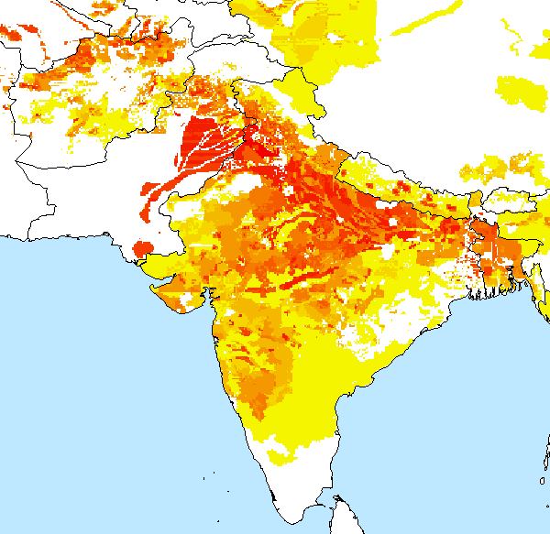
Initial Target Country / Areas for Zinc Wheat
ME1: Temperate Irrigated High Production NWPZ
ME5: Irrigated High Temperate Stress EGPZ
12 µgg⁻¹
Target Increment to be added
Baseline Micronutrient Level in Commercial Crop 25 µgg-1
Notes:
India is ranked second in the world with respect to the number of children suffering from malnutrition, despite its impressive economic growth. The absolute numbers and the prevalence of young children affected by stunting, underweight, and wasting have not changed significantly in the last two decades, it is estimated that less than 55% of women and children receive any basic health and nutrition interventions. The 2008 Global Hunger Index (GHI - a composite indicator that accounts for inadequate food consumption, child underweight and mortality) ranked India 66th out of the 88 developing countries for which the GHI was calculated, slightly above Bangladesh and below all other South Asian countries. Within India, the state-specific GHI’s highlight wide regional disparities: Punjab ranks 34th (comparatively between Nicaragua and Ghana) and Madhya Pradesh ranks 82nd (between Chad and Ethiopia). However, even the best performing state, Punjab, ranks below countries like Honduras and Gabon, and none of the states falls in the “low hunger” or “moderate hunger” category defined by the GHI 2008.
Von Grebmer et al. The Challenge of Hunger 2008: Global Hunger Index. 2008. Concern Worldwide. Accessed via internet on April 30, 2013 (http://www.ifpri.org/publication/challenge-hunger-2008-global-hunger-index)

Slide 11
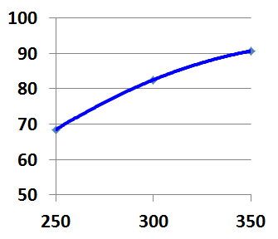
% of Physiologic Requirement¹⁾ for Zinc achieved by different Levels of +12ppm Zinc Wheat Intake
¹⁾ Woman in child bearing age
% Requirement
Consumed g/day
Notes:
Physiologic requirement = absorbed amount

Slide 12
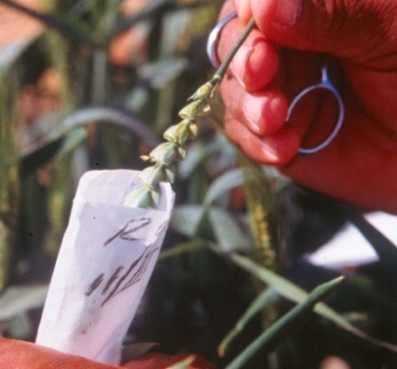
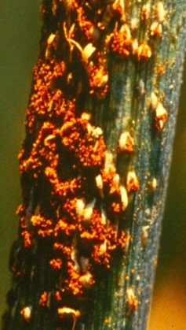
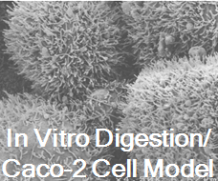
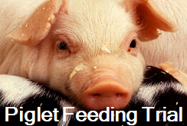
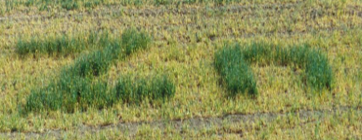
HarvestPlus Impact & Product Pathway
Development: HPlus II 2009-2013
Nutrition Retention and Bioavailability
Crop Development
Nutritional Efficacy Studies on Human Subjects
GxE Performance Testing in Target Countries
Notes:
Combination of target micronutrient trait with attributes required such as Ug99 resistance and traits which trigger adoption by farmers such as competitive yield
Biofortification is an evidence-based intervention linking agriculture and nutrition

Slide 13
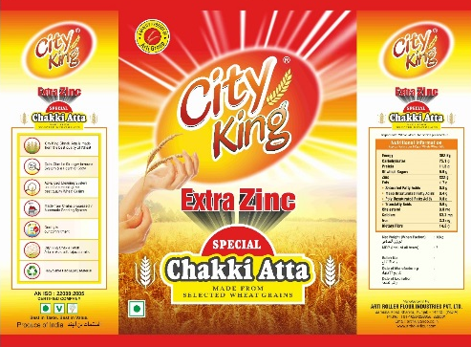
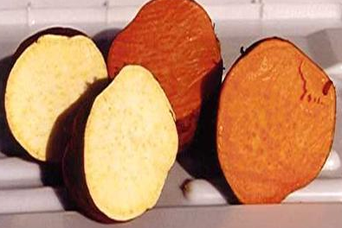


HarvestPlus Impact & Product Pathway
Delivery: HPlus III 2014 - 2018
Release C
Seed Production Launch | Test Marketing
Delivery | Commercialization Marketing
Awareness | Demand Creation Acceptability Studies\ Extension
Conventional & Electronic Markets
Market & Product Development
Advocacy
Shakti man
Notes:
Advocacy: Project Visibility; Policy Integration; Advocacy Strategy; Dissemination, Marketing, Consumer Acceptance …; Variety Release, Extension, Seed Systems …
Trait visibility

Slide 14

Will Biofortification Work?
Can breeding increase nutrients to levels that improve nutrition?
Notes:
However, for biofortification to deliver on its promise, three things must happen

Slide 15
Main criteria to identify selectable traits & estimate potential genetic gains
Existing genetic variation, trait heritability, gene action, associations among traits, available screening techniques / trait diagnostic tools
Product Development Goals
Technological
+
Production
+
Commercial
Legal
Regulatory
Identify Trait
Proof-of-Concept Gene/Allele Discovery Screening, Diagnostic Tool development
Product Development
Competitive / profitable agronomic, economic, nutrition, end-use quality performance
Manage design and delivery of the technology

Slide 16
Wheat Iron and Zinc Variation in Kazakhstan
Iron ….mgkg⁻¹
Zinc ….mgkg⁻¹
A. Morgounov,
CIMMYT-Kazakhstan

Slide 17
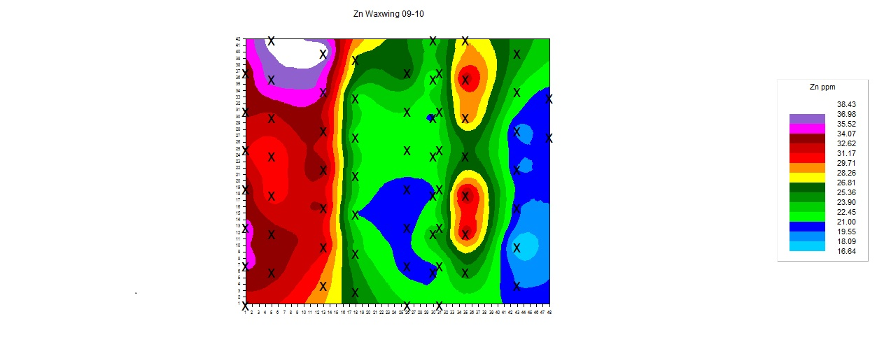
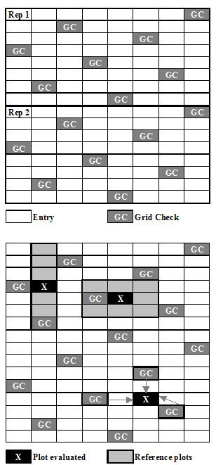
Generating uniform Zinc Selection Environments
CIMMYT, Cd. Obregon, Sonora
Zinc ppm
Spatial design & Techniques
Soil Zinc Application

Slide 18

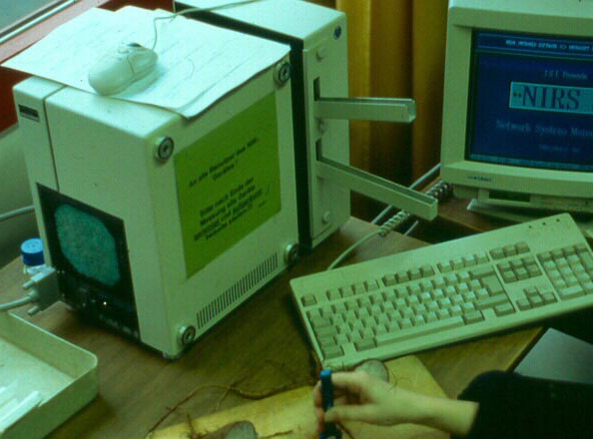
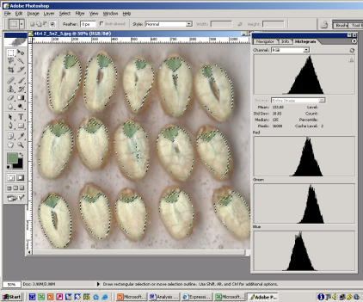
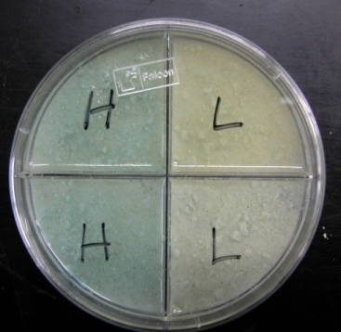

Development of High-Throughput Methods
Precision Methods
$US Cost Sample⁻¹
Minerals ICP: $US15/sample
Samplesday⁻¹
pVAC HPLC: $US 35-75/sample
< 1
300
X-Ray
5
XRF
Near Infrared Reflectance Spectroscopy
Multitude of Elements
200
NIRS
Image Analyzer
Zn/Fe, pVAC compounds e.g. % Protein
Semi-Quantitative
100
Colorimetric
Qualitative
2005
Year
2010
Notes:
18

Slide 19
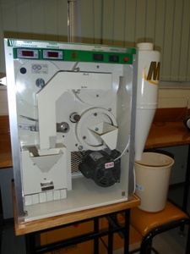
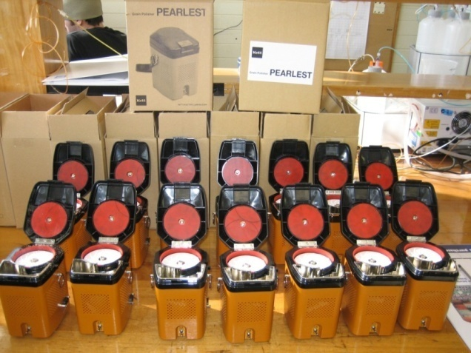
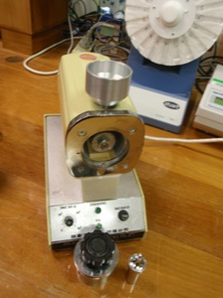
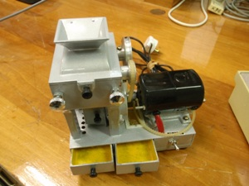
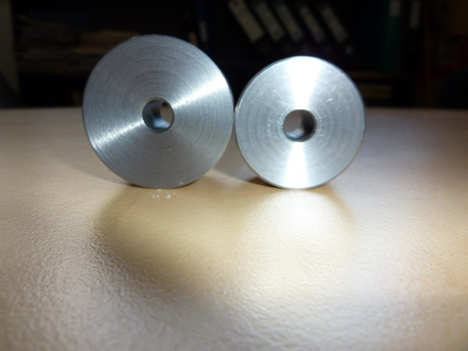
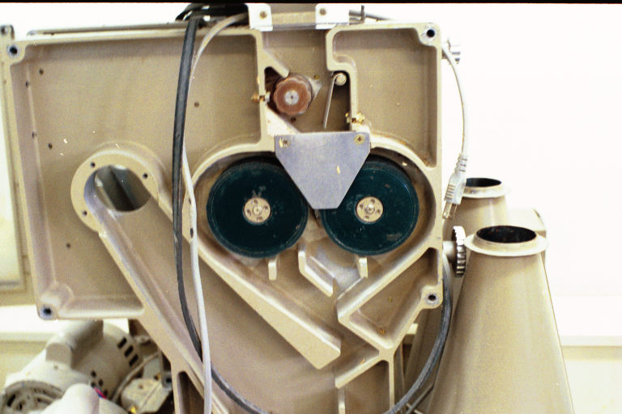
Non-contaminating mills/grinders modified and distributed to CGIAR & NARS Partners
James Stangoulis, Flinders University, Adelaide

Slide 20
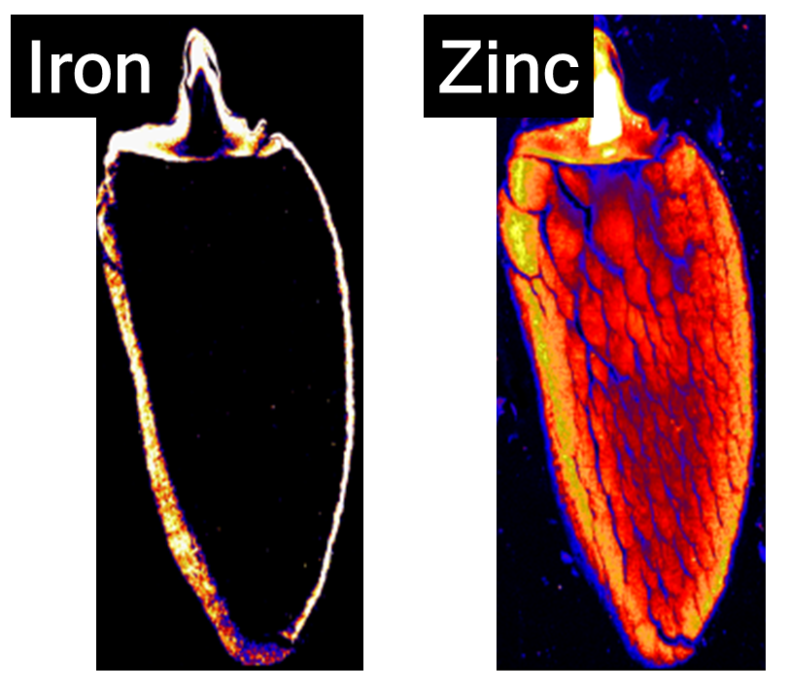
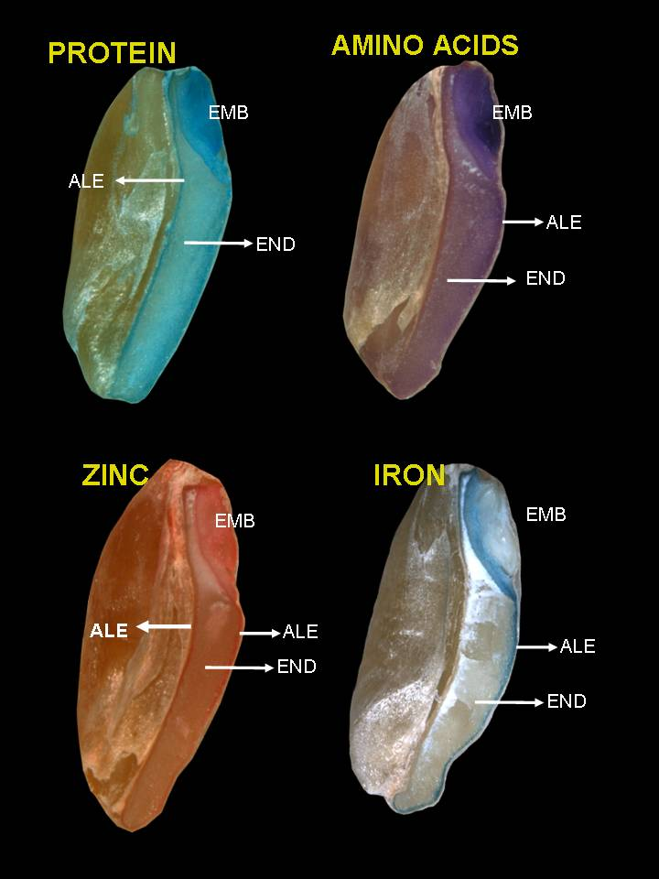
Localization of Iron & Zinc in Cereals
Rice
Wheat
Concentrated in Aleurone, Embryo & Vascular Bundles
Aleurone & Sub-Aleurone
Zinc
Iron
Deep into Endosperm
Cakmak et al., 2010.

Slide 21
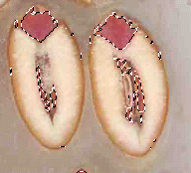
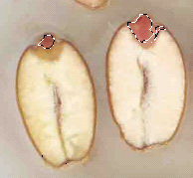
Protein
Amino Acids
Co-localization
High Zinc Wheat
Zinc
Iron
Embryo
Aleurone
Endosperm
Low Zinc
Cakmak et al., 2010

Slide 22
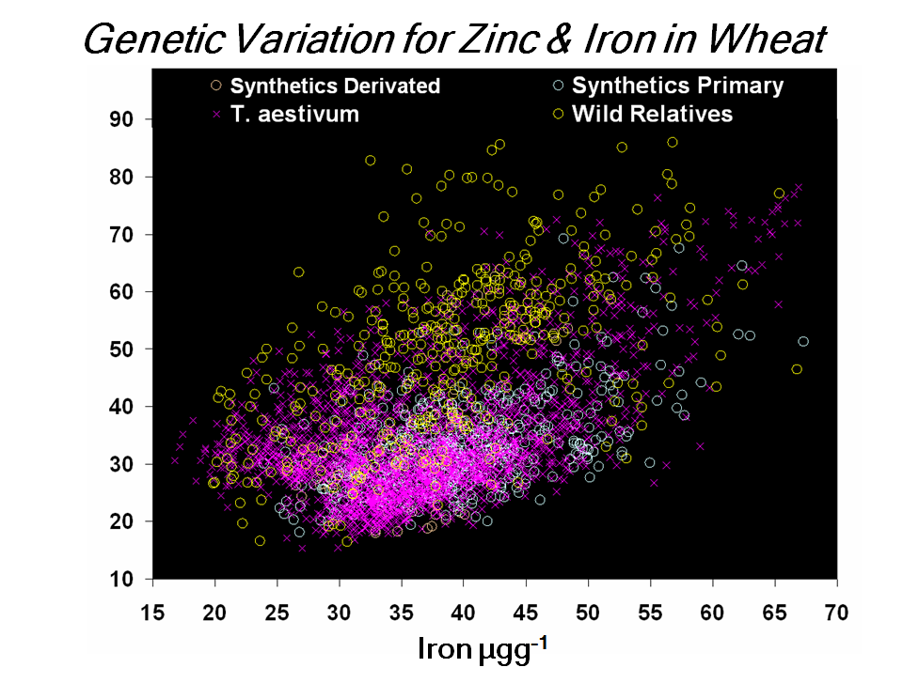
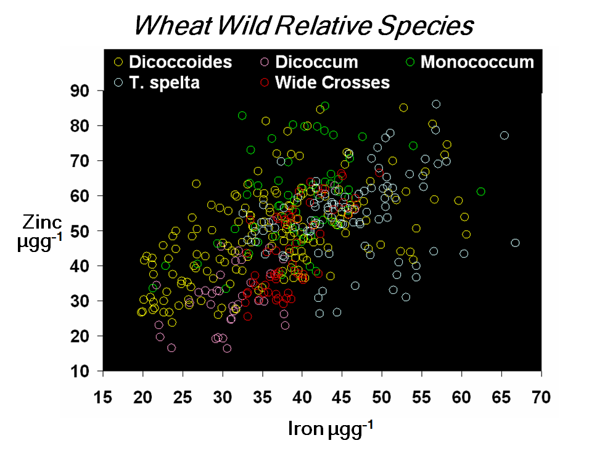
Genetic Variation
Variation for micronutrients to surpass the target in wild relative species / unadapted germplasm
Lack of genetic variation in adapted, high yielding genotypes
Notes:
The figure displays that among the wild relative species, hexaploid T. spelta emerged as best source to increase both Zn and Fe. Early efforts had concentrated on tetraploid T. dicoccum and T. dicoccoides

Slide 23
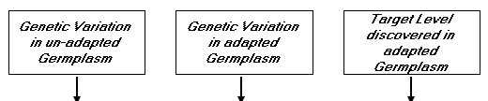
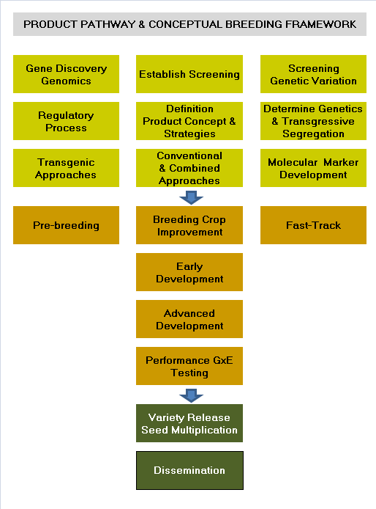
Crop Improvement Approaches
Select for agronomic attributes 1st, the for micronutrient density
On-farm demos
Participatory Variety Selection
Engaging all actors along the value chain
Aggressive
Multilocation Testing substituting temporal by spatial variation to shorten Time-to-Market

Slide 24
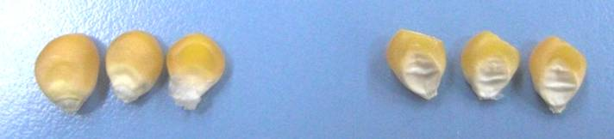
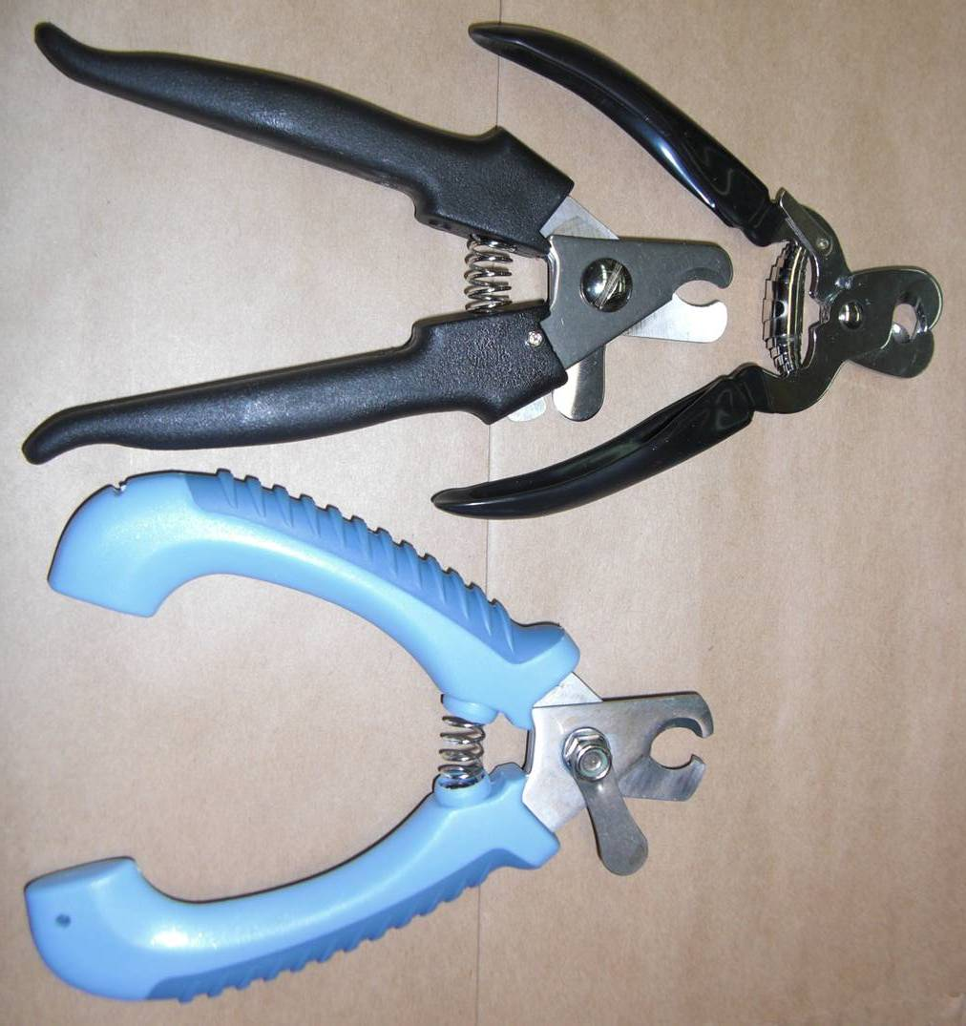
Molecular Marker Development & Application
Lycopene Epsilon Cyclase LCYE affects ratio of carotenoids
GGPP
β-hydroxylase HYDB1 large effect on β-carotene levels & β-carotene / total carotenoids ratio
PSY
PDS
Z-ISO
ZDS/CRISTO
lycopene
LCYE
LCYB
δ-carotene
γ-carotene
LCYB
LCYB
HYDB3 3rd gene
α-carotene
β-carotene
HYDb
HYDb1
zeinoxanthin
β-cryptoxanthin
HYDE
HYDb3
lutein
zeaxanthin
Non destructive - Leaf or Seed DNA
ABA
Notes:
3rd gene CRTR-B3 = HYDB3; (10%) PSY1 total + LCYE ratio + HYDB1 β-carotene explain >70% of β-carotene; mention one marker for PSY1 (10%); AABB versus aabb -> 9x difference in 1 pop; correlations among oil (2 genes -> go from 3-4% to 4-5%) – Vita E – Vita A; J. Yan, S. Gao, , Babu, M. Warburton, Y. Xu

Slide 25
Trait Diagnostic Tools - Zinc QTL Discovery
~25 QTL identified on 16 different chromosomes in diploid (T. monococcum & T. boeoticum), tetraploid (T. dicoccoides & T. durum), or hexaploid wheat (T. aestivum) sources
 | Chromosome
Genome | 1 | 2 | 3 | 4 | 5 | 6 | 7
A | T.monococcum ID-362, T.aestivum, Adana x 70711 | T. durum Langdon, T. dicoccoides G18-16 | T.aestivum, Kenya Swara, T. aestivum, Adana x 70711 | T. aestivum Hanxuan 10 | T. aestivum Hanxuan 10, T. dicoccoides G18-16, T. aestivum Xiaoyan 54, T. monococcum ID-362 | T.spelta H+26 (PI 348449), T.aestivum Picus/Francolin, T. aestivum Seri x SYN | T. aestivum, Adana x 70711, T.aestivum Lumai, T. dicoccoides G18-16, T. boeoticum Pau 5088, T. monococcum Pau 14087, T.aestivum RAC875-2
B | T.aestivum Picus/Francolin, Berkut x Krichauff, Adana x 70711, T. durum Saricanak x MM5/4, | T.aestivum PBW 343 X Swara, T. aestivum HUW 234, Berkut x Krichauff, T. aestivum, Adana x 70711 |  | T. aestivum Seri M82 x SYN, T. aestivum Jing 411, T. aestivum RAC875-2 | T.aestivum Picus/Francolin | T.aestivum, Seri x SYN, T.dicoccoides G18-16, T.dicoccoides LDN (DIC-6B), T.durum, Saricanak x MM5/4 | T. dicoccoides G18-16
D | T.aestivum Adana x 70711 |  | T.aestivum Picus/Francolin | T.aestivum Lumai 14
Mapping population: Black = outside CIMMYT research; Red = CIMMYT, Mexico work; Green = BHU/CIMMYT-India research; Orange = Turkish populations mapped at CIMMYT
Courtesy of R.P. Singh, CIMMYT

Slide 26
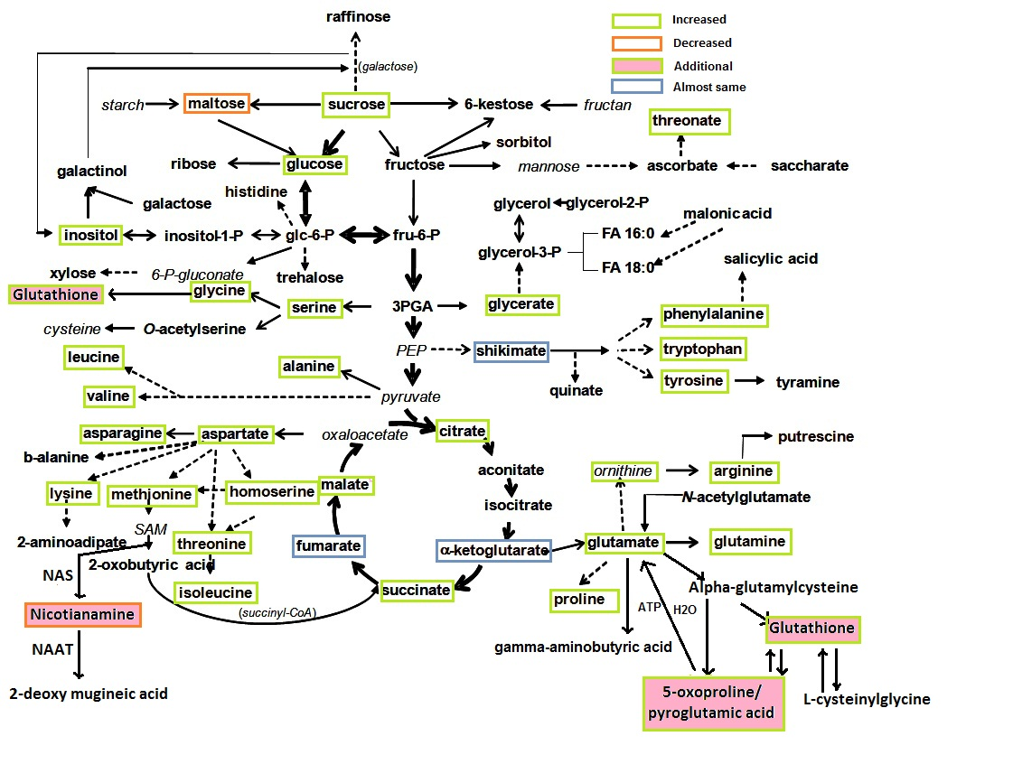
Metabolite Profiling is Useful in Trying to Explain Genotypic Differences in Grain Nutrient Content and Its Use Will be Explored Further In Marker Work

Slide 27
Conceptual model for increased metal transport in Wheat
James Stangoulis, Flinders University, Adelaide
High levels of metal unloading immediately after anthesis that leads to higher turnover rates for the metals between grain crease and the endosperm
In seed, more mobile metal chelators (i.e. NA) in pathway to endosperm that leads to less storage in vacuoles
More transfer cells between xylem and phloem at xylem discontinuity
High levels of solute (eg sucrose, K) in phloem that lead to higher phloem transport rates and more metal being transported to the grain
High levels of chelators (i.e. citrate, NA?) in xylem as metals are transported to vegetative tissues
Efficient loading of metals from vegetative tissue to phloem for translocation from to seed; high levels of chelators (eg nicotianamine, glutathione, cysteine, histidine) in phloem
Increased uptake of metal into phloem at the root/shoot interface. In barley, phloem at this zone supplies young leaf tissue and possibly seed
Enhanced efflux of metal from xylem parenchyma into the xylem. Possibly linked to high expression of citrate effluxer
Increased release of phytosiderophores that leads to greater metal uptake
Large root system. More research required on the role of root morphology, exudation and microorganisms on metal uptake

Slide 28
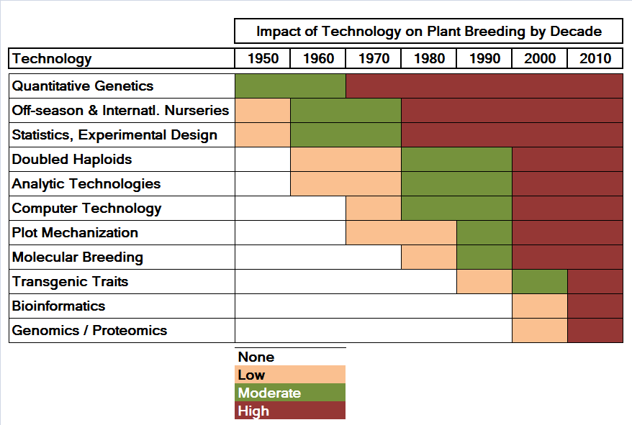
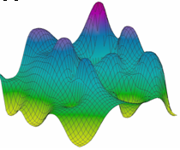
Technology Evolution Which How and When to Apply in Breeding Process
Use of modeling / simulation regarding technical approach and for economic analysis with CAAS

Slide 29
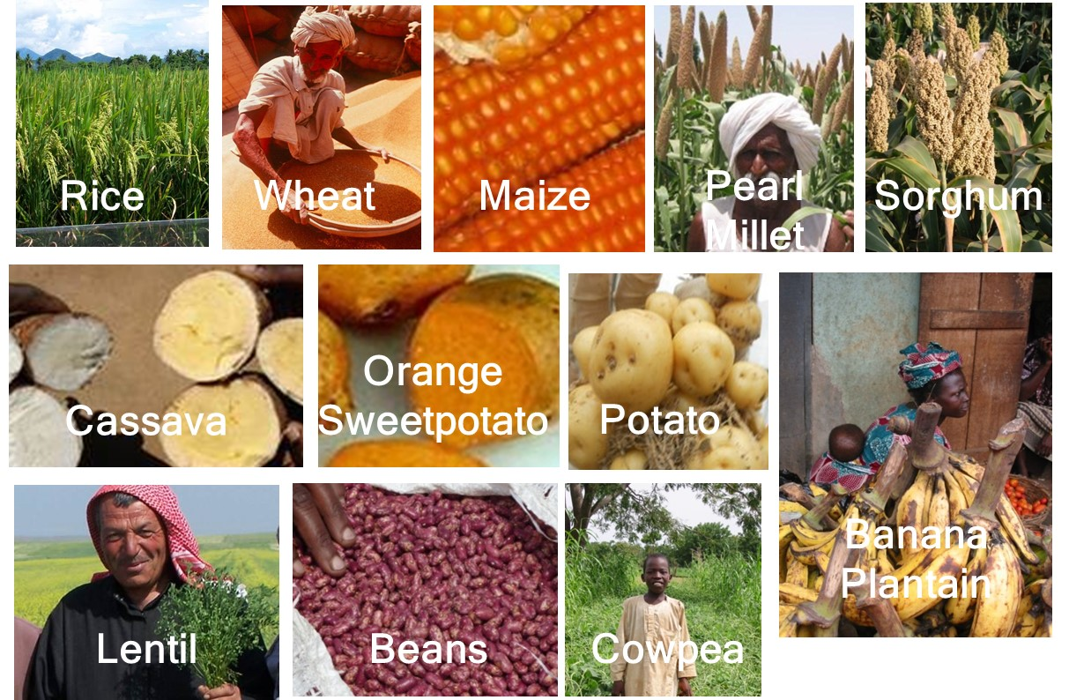
>120 varieties released in 26 countries In-testing in 56 countries

Slide 30
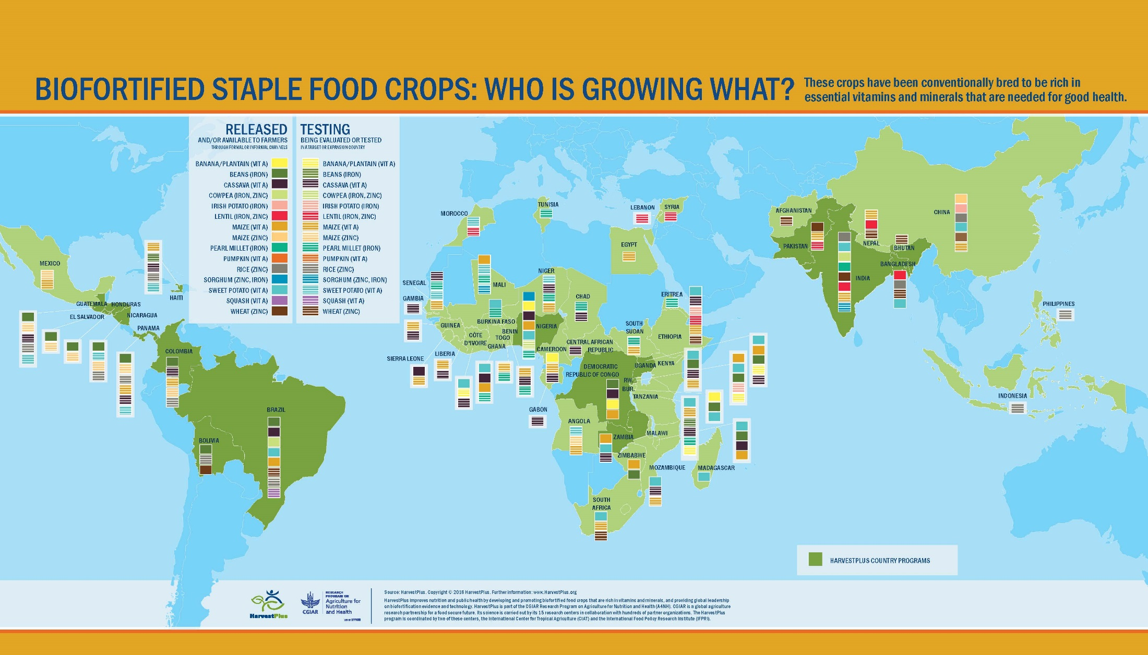
Biofortified crops in-testing in 56 countries
Notes:
In the last 13 years, biofortified varieties of 6 crops (vitamin A OSP, cassava and maize; iron beans and zinc rice and wheat) were released in over 30 countries and were in multilocation testing in 40+ countries. HarvestPlus investments have filled current breeding pipelines with varieties that are agronomically competitive, disease resistant and include preferred end-use qualities, as well as contain their full target levels of micronutrients.

Slide 31
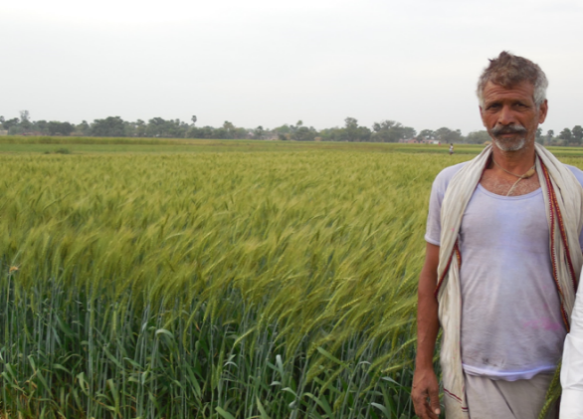
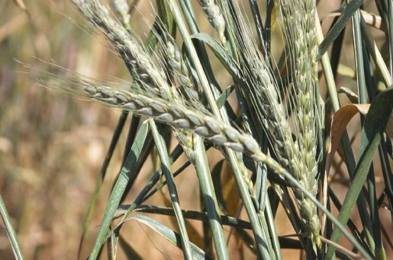
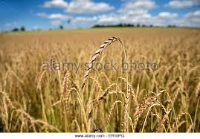


From genetic resources to High zinc wheat in farmers’ fields of South Asia in less than 10 years
Progenitors:
Zn-Shakti’
Extra-early adopted. Seed delivered to >40000 farmers in NEPZ
T. durum based SHW
=
Zincol 2016:
1st high zinc wheat in Pakistan. 2000 tons of seed to be sown in 2016-17
=
T. spelta
High yielding lines with high Zn from Iranian and Mexican landraces and other sources also developed & distributed
Two lines identified in 2016 for release in NWPZ of India
T. dicoccon

Slide 32


Will Biofortification Work?
Are the extra nutrients bioavailable at sufficient levels to improve micronutrient status?
Notes:
Zinc in wheat

Slide 33
How do we know zinc wheat works?
Demonstrated that zinc in biofortified wheat is well absorbed by women of child bearing age in Mexico and Switzerland
Notes:
Demonstrated that zinc in biofortified wheat is well absorbed by women of child bearing age in Mexico and Switzerland
ETH-Zurich & St. John’s MRC: Bangalore 5 months (directly supervised consumption), 6 days/week 120 g wheat flour/child/
Peri-urban areas near New Delhi, 6-month trial Center for Micronutrient Research, Subharti Medical College, Uttar Pradesh Center for Public Health Kinetics, Delhi
1,300+ children 4-6 years, 1,300+ mothers 15-49 years in each arm at endline.
Intervention Subjects
Children +1.2 mg Zn/day from high zinc wheat; baseline zinc intake of perhaps 7 mg Zn/day (+17%)
Mothers +3.0 mg Zn/day from high zinc wheat; baseline zinc intake of perhaps 10 mg Zn/day (+30%)

Slide 34
Results demonstrated:
Absorption Study
Biofortified wheat flour consumption provides nearly 70% more Zn than commercial conventional wheat, irrespective of whether the flour is white or Atta (whole wheat) flour
Efficacy Trial
Effect of High Zinc Wheat Intervention on Morbidity Indicators in children 4-6 years of age and in woman 15—49 years of age.
Value of High Zinc Wheat Intervention Due To
Morbidity Indicators estimated at >30 million $US per
year
Notes:
Providing 200 g of biofortified wheat per day in an efficacy study will therefore provide an additional 0.89 mg of absorbed Zinc (in case of provision of 100g of wheat 0.44 mg Zn of absorbed Zn per day will be provided).

Slide 35
Will Biofortification Work?
Will farmers adopt these crops and will consumers buy & eat in sufficient quantities?

Slide 36


Target Micronutrients: Zinc, Iron, provitamins-A
Factors prerequisite for product adoption:
Iron & Zinc invisible traits → product attributes e.g. agronomic superiority
pVAC = provitamin-A Carotenoids visible traits → in addition product acceptability by producers and consumers
Orange Sweetpotato
Cassava
Gari
Nhsima
Roots

Slide 37

Value Proposition - Crop & Marketing Options
Grower/Consumer
Added Value: awareness re nutritional/health benefit of
micronutrient … higher profit via higher yield … sensory,
processing characteristics …
Marketing options – e.g. higher price, market for
biofortified grain
Value Chain → Supply & Demand Side
Marketing options for seed &
grain / processed products
Consumer
Added Value: nutritional / health
health … lower price … sensory
or processing characteristics
Notes:
Crop options & marketing options; Awareness both on the supply and demand side

Slide 38



Farmer preferred Trait Packages
Participatory Variety Selection in Lead Identification
Seed production BHU6 2015
Notes:
Crop and marketing options for all farmers - including subsistence
erformance: agronomic, micronutrient, end-use quality including forage

Slide 39

Awareness & Demand Creation are Key in Developing Sustainable Markets
A mammoth crowd waiting to receive stems at the Governor’s office in Abia

Slide 40





Related Marketing Activities
Advertising
  Radio
  TV
  Print
  Public service
  Market Loudspeaker
Promotional Materials
  Pamphlets, circulars
  Brochures
  Point of purchase (POP)
  Billboards, banners, posters
Education/promotion
  Concerts, street theater
  Road shows, fairs
  Health center meetings & training
  Public sector meetings & training
  Endorsements
Metrics
  Measuring Marketing - Sales - PR Effectiveness
Premiums
  T Shirts, hats, bags, pens, etc.

Slide 41



Marketing – Consumer Goods - Wheat
Create demand in particular for main channel processed products such as flour in generating pull in market development
Shakti man
Notes:
Up-scaling challenges

Slide 42

>4 million Farming Households are growing biofortified crops in 2016 providing access to Biofortified Food for >20 million
2016: 3 million Farming HHs directly reached
2020 Goal: 100 million people benefitting from biofortified crops delivered by HarvestPlus and other initiatives

Slide 43

2016 World Food Prize for Combating Malnutrition
Biofortification Recognized as a Global Public Health Intervention using Agriculture as Vehicle
Thank You!

